Slide 1
Faculty Senate Meeting
26 June 2025

Slide 2
Meeting procedure
Only Senators may debate motions
Only Senators can vote
If you are not a Senator, or a proxy, you cannot vote or debate
Do not speak over someone, or out of order
  Raise your hand (For those online please use “Raise Hand” on the Zoom app)
  The President will call on you and then you will have the floor
  Please wait for the microphone
Unless you have been recognized (told you have the floor), you may not speak

Slide 3
I. Call to order
D. Westenberg, President

Slide 4
II. Roll Call
J. Schlegel, Secretary

Slide 5
III. Consent Agenda
D. Westenberg

Slide 6
Consent Agenda
Approval of the 24 April 2025 Minutes
Campus Curriculum Committee moves to approve CC and DC forms from their last meeting

Slide 7
IV. President’s Report
D. Westenberg

Slide 8
IFC – 5/5/2025, In Person
Topics discussed
Voluntary defined contribution opt-in
  Pending Curators' approval (voting today).
Benefit Managers: RFPs ongoing for medical and pharmacy.
Digital Accessibility
  Federal law, will be effective April 24, 2026.
  Campus-wide effort.
Dave Westenberg will be Chair of IFC next year.

Slide 9
Campus Matters
Leadership Meetings
See Miner Momentum for topics discussed
Enrollment Workshop
  Melt reduction, K-12 engagement, communication strategy, etc.
Regional Innovation Ecosystem report
Christine Karslake, Assoc. VC Innovation, Entrepreneurship, and Commercialization
  Five-Year Plan – Training and support for disclosures, patents, start-ups

Slide 10
Campus Matters
Leadership Meetings (cont.)
TalkCampus – Student Support App
Instructor badging system
Advising structure updates

Slide 11
Campus Matters
Proposed changes to FS meetings
Requiring in person for quorum
RP&A 2 weeks in advance – motions within one week
Voting done online.
Electing committee chairs before end of April per CRR
Committee meeting schedules, minutes, annual reports.
Location – work in progress

Slide 12
Campus Matters
Good News
New Provost - John Harris
Retention is up

Slide 13
Be Involved
Be Engaged
Do Something

Slide 14
V. Campus Reports
A. Staff Council
K. Walkup

Slide 15
Staff Council
No report

Slide 16
V. Campus Reports
B. Student Council
M. De La Hunt

Slide 17
Student Council
No report

Slide 18
V. Campus Reports
C. Council of Graduate
Students

Slide 19
Council of Graduate Students
No report

Slide 20
VI. Special Topics
A. Digital Accessibility
S. Murray

Slide 21
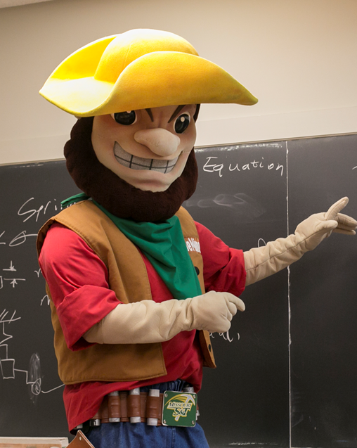
Title II Update
  All digital content must be accessible by April 2026
  CAFE one-hour training available
    See eConnection or Percipio for dates
  Color contrast checking software
    AppsAnywhere
  Write formulas using MathPix $40/user/year - coming soon
  Ally to review Canvas site – coming soon
  Sites.mst.edu/digitalaccess
    S&T’s Eight Essential Steps for Digital Accessibility
  Missouri Online renamed Academic Technologies has many online trainings available to anyone in the UM system
    https://teaching.missouri.edu/accessibility

Slide 22
VII. Committee Reports
A. Administrative Review
K. Erickson

Slide 23
2024-2025 Members
Kelvin Erickson, Chair
Ali Hurson
Bih-Ru Lea
Kelly Liu
Jorge Porcel
Matt Thimgan

Slide 24
Positions Approved for Review
  Chancellor
  Vice Chancellor for Research & Innovation
  Vice Chancellor for University Advancement
  Vice Chancellor of Strategic Initiatives
  Vice Provost and Dean of CASE
  Vice Provost and Dean of CEC
  Vice Provost of Enrollment Management

Slide 25
Timeline and Process
Action | Time
Review list to faculty senate for approval | November 21, 2024
Job descriptions | December 2024
Development of questionnaires
Questionnaires to FS for review/approval | January 30, 2025
Statement of accomplishments due | February
Review of administrators | March 10 - March 21
Results to FS officers | May 6
Results shared with reviewees | May 15 - 22
Final report to FS | June 26

Slide 26
The Review Process
The surveys were loaded onto Qualtrics after being tested extensively to ensure that the surveys worked on all platforms, maintained confidentiality, and could only be completed once by an individual.
The surveys were conducted between March 10 and March 21. Multiple reminders were sent out via email and eConnection.
The reports were downloaded and reviewed by the ARC and then by FS Officers on May 6 to identify any inappropriate comments and comments that could reveal the identity of the person completing the review.
The reports were delivered by Kelvin and K.C. in May to the individuals reviewed.
The reports were also emailed by Kelvin to their respective supervisor.

Slide 27
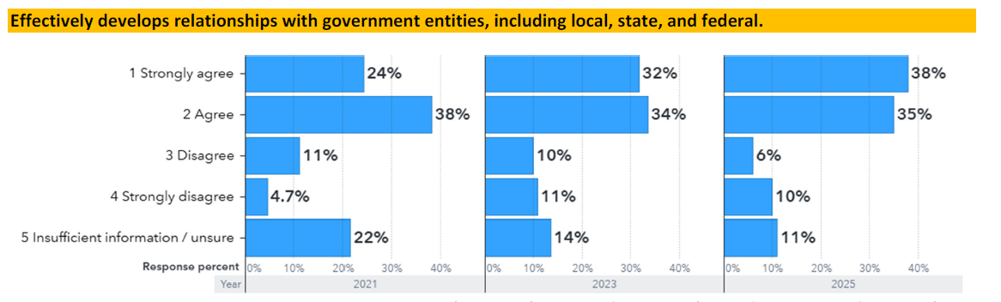
Chancellor Dehghani
Example: Positive

Slide 28
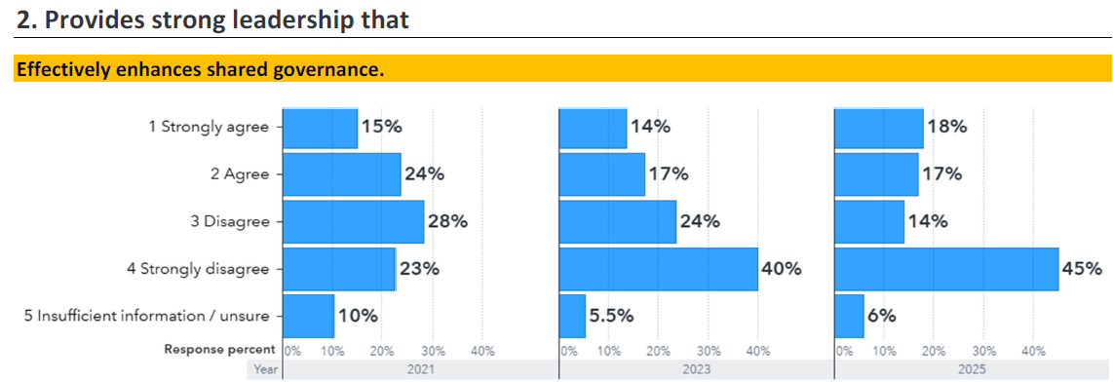
Chancellor Dehghani
Example: Needs Improvement

Slide 29
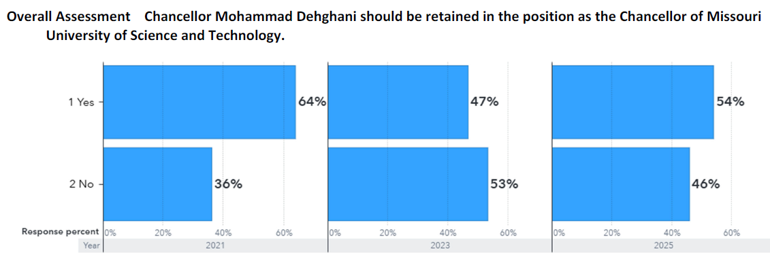
Chancellor Dehghani
Overall

Slide 30
Chancellor Dehghani– 62 comments
Positives
Strong and effective relations with external entities and alumni
Strong campus leader
Suggested Actions
Delegate more to direct reports
Take steps to enhance shared governance with the faculty, such as seeking faculty opinions before making major initiatives or policy changes
Promote more messages about the people and less about the new buildings

Slide 31
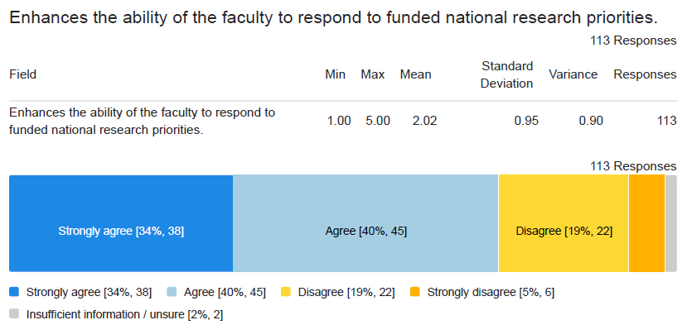
VC Research & Innovation – Kamal Khayat
Example:
Positive

Slide 32
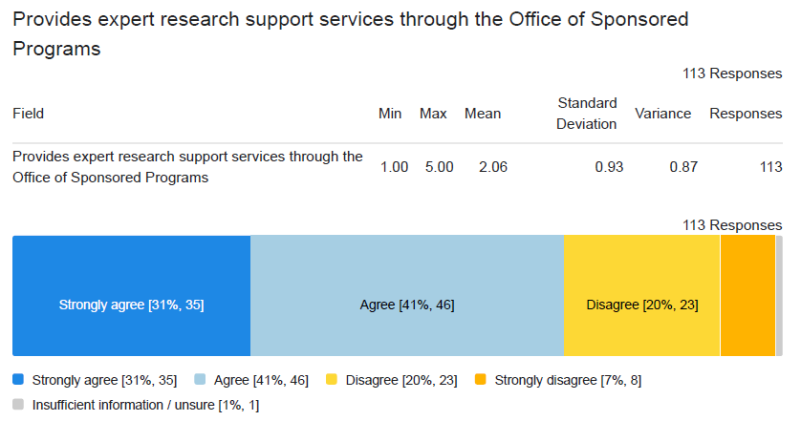
VC Research & Innovation – Kamal Khayat
Example:
Less
Positive

Slide 33
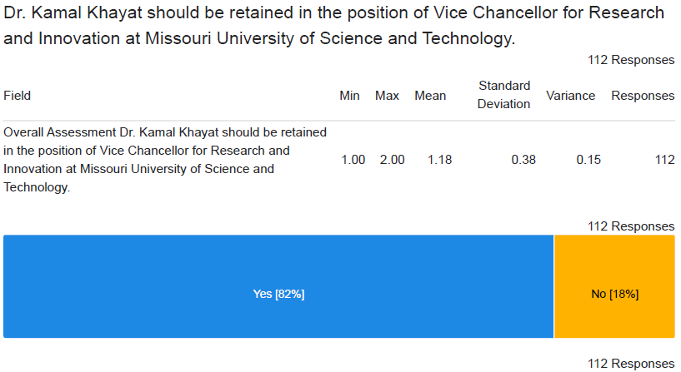
VC Research & Innovation – Kamal Khayat
Overall

Slide 34
VC Research & Innov. – Kamal Khayat– 44 comments
Positive
Enhances the faculty’s ability to respond to funding opportunities
Suggested Action
More oversight of OSP operations

Slide 35
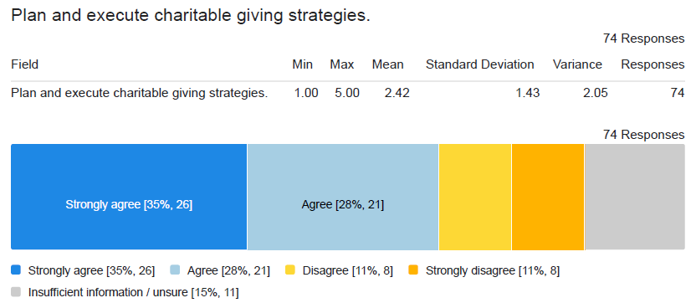
VC Univ. Advancement - Tori Verkamp
Example:
Positive

Slide 36
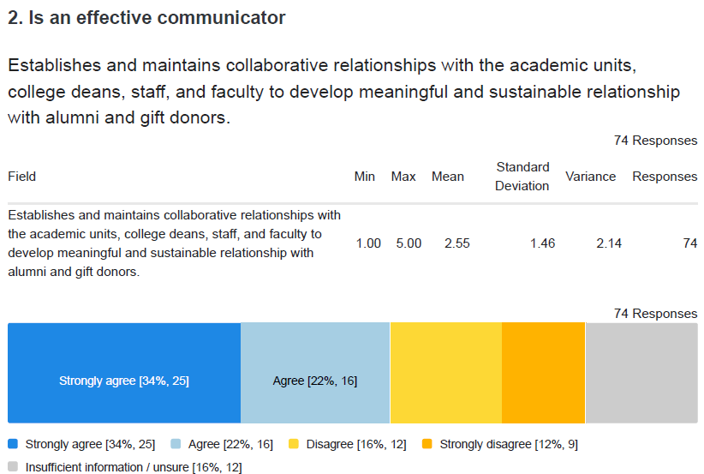
VC Univ. Advancement - Tori Verkamp
Example:
Less
Positive

Slide 37
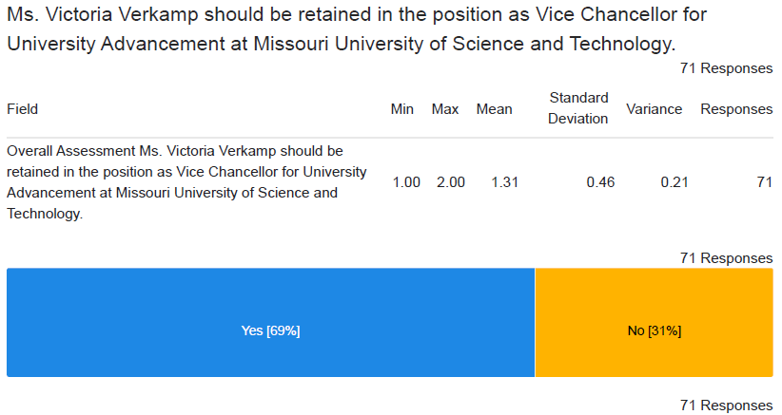
VC Univ. Advancement - Tori Verkamp
Overall

Slide 38
VC Univ. Advancement - Tori Verkamp– 27 comments
Positives
Effectively plans and executes charitable giving strategies
Suggested Action
Annually, one member of the VC Advancement staff meet with each academic department’s faculty to ascertain their needs and communicate the University Advancement initiatives

Slide 39
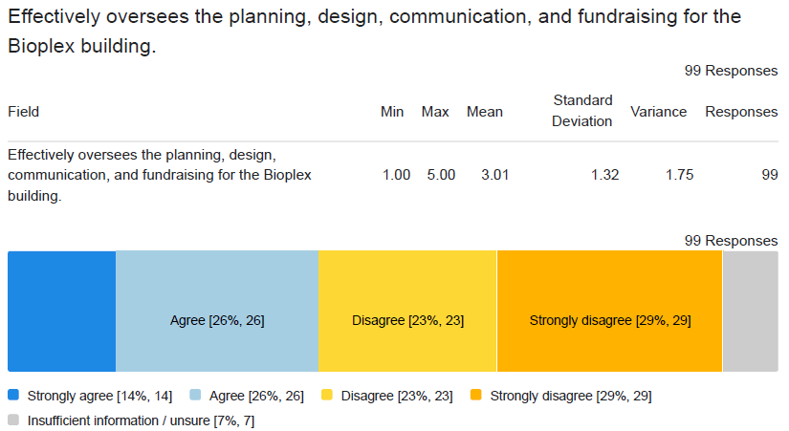
VC Strategic Initiatives – Steve Roberts
Example:
Positive

Slide 40
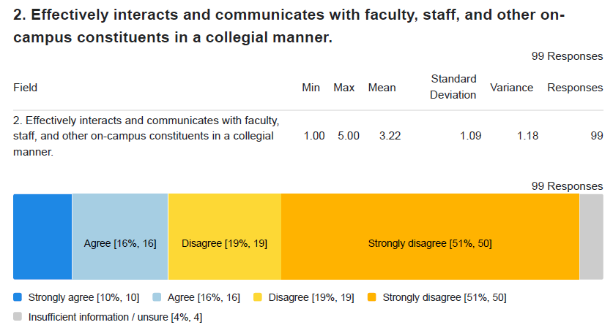
VC Strategic Initiatives – Steve Roberts
Example:
Needs
Improvement

Slide 41
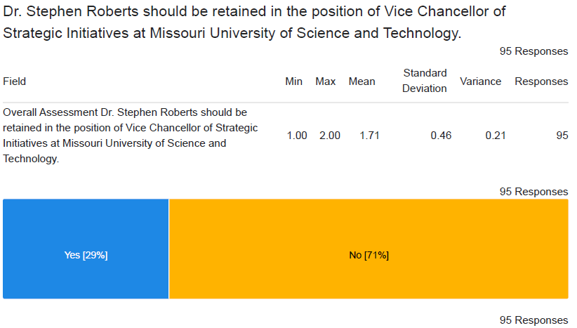
VC Strategic Initiatives – Steve Roberts
Overall

Slide 42
VC Strat. Initiatives – Steve Roberts– 42 comments
Positive
Strong advocate for bio-X initiatives (could be viewed as a negative by some)
Suggested Action
Improve communication with regular communication to the faculty and staff about the progress of the strategic initiatives and initiatives in the planning stage

Slide 43
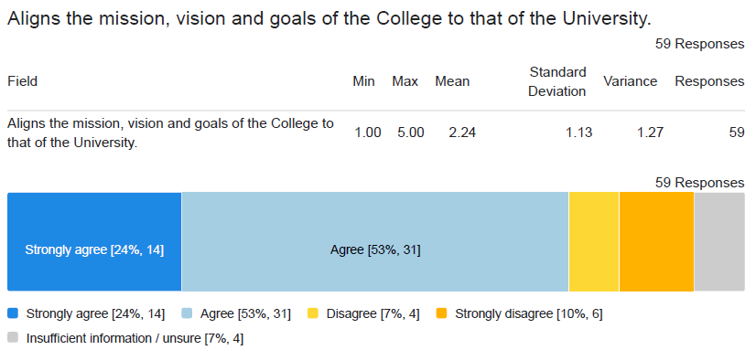
VP and Dean of CASE – Mehrzad Boroujerdi
Example:
Positive

Slide 44
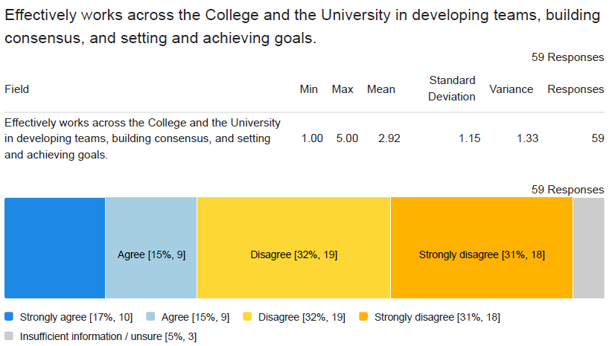
VP and Dean of CASE – Mehrzad Boroujerdi
Example:
Needs
Improvement

Slide 45
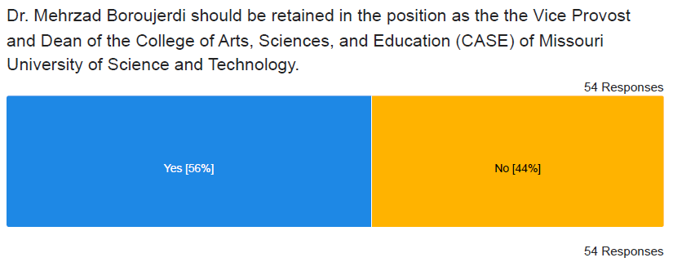
VP and Dean of CASE – Mehrzad Boroujerdi
Overall

Slide 46
VP and Dean of CASE – Mehrzad Boroujerdi– 24 comments
Positive
Aligns goals of the college to the campus goals
Suggested Actions
Improve communication with college faculty and staff about “what’s happening” and “what’s on the horizon”, such as monthly emails, quarterly/semesterly town/college-halls, etc.
Support the faculty that are focused on teaching by recognizing that teaching can carry equal weight to research. Don’t use teaching load as a punishment

Slide 47
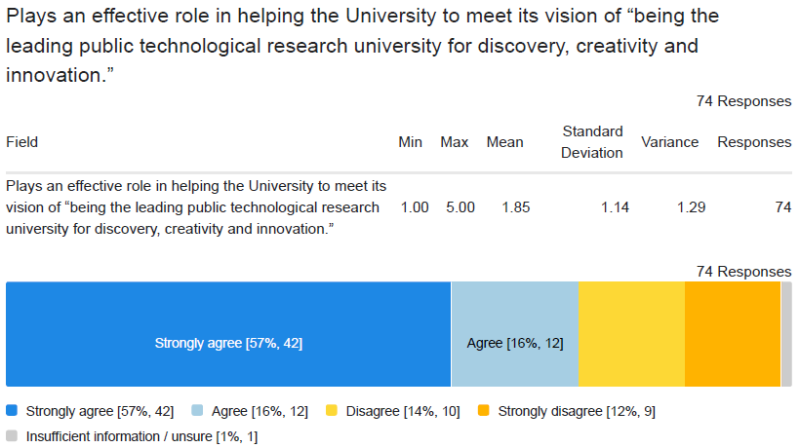
VP and Dean of CEC – David Borrok
Example:
Positive

Slide 48
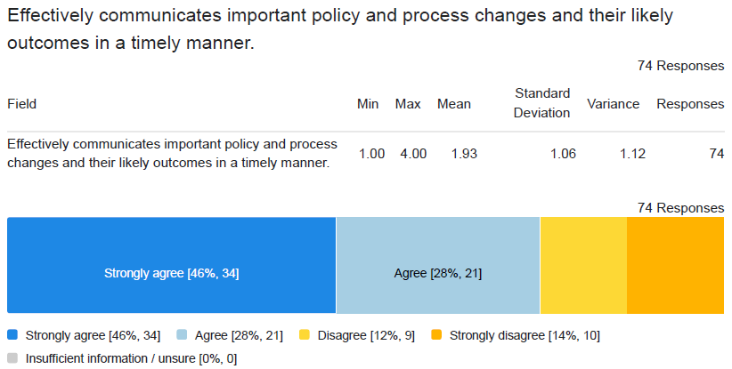
VP and Dean of CEC – David Borrok
Example:
Less
Positive

Slide 49
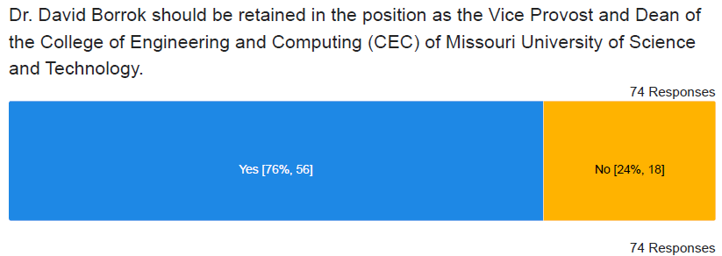
VP and Dean of CEC – David Borrok
Overall

Slide 50
VP and Dean of CEC – David Borrok– 29 comments
Positive
Interacts collegially with faculty, staff, and students
Aligns goals of the college to the campus goals
Suggested Actions
Improve communication with college faculty and staff about “what’s happening” and “what’s on the horizon”, such as monthly emails, quarterly/semesterly town/college-halls, etc.

Slide 51
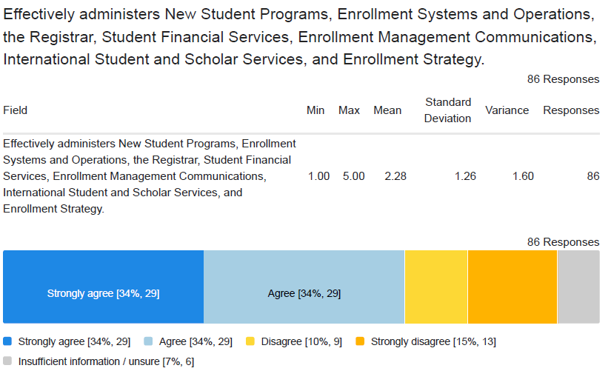
VP Enrollment Management – David Spivey
Example:
Positive

Slide 52
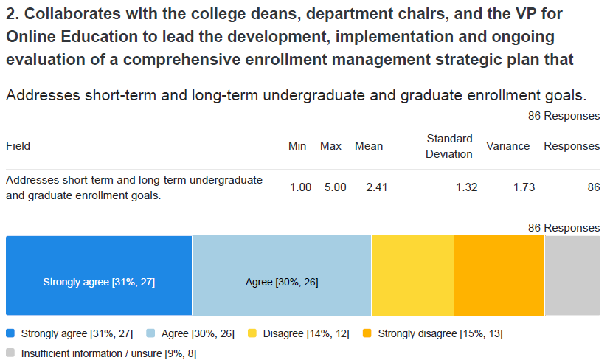
VP Enrollment Management – David Spivey
Example:
Less
Positive

Slide 53
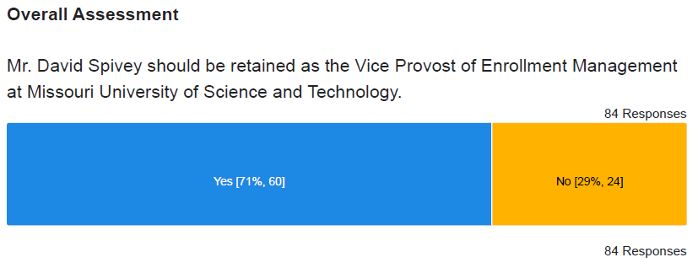
VP Enrollment Management – David Spivey
Overall

Slide 54
VP Enrollment Mgmt. – David Spivey– 34 comments
Positives
Effectively administers the departments under his responsibility
Suggested Action
Focus more efforts on non-engineering disciplines

Slide 55
VII. Committee Reports
B. Budgetary Affairs
B. Lea

Slide 56
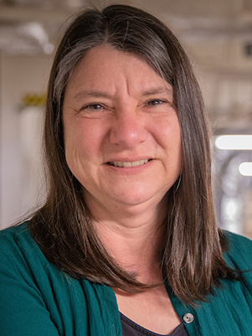
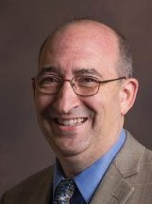
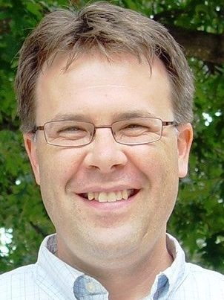
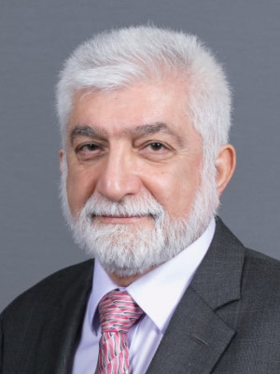
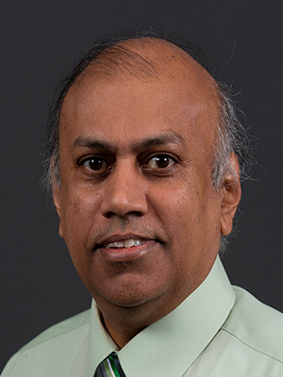
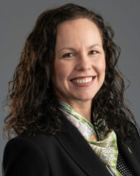
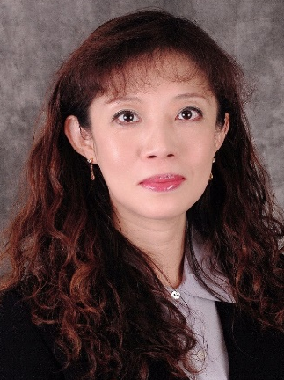
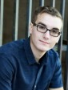
Budgetary Affairs Committee (BAC)
6-26-2025 Report
Emerging Issues & Referrals
  Actions for Salary & Hiring Trends
  Distribution of Sponsored Research Indirect Recovery
  2025-26 Salary & Merit Raise Update
  New Bookstore Vendor Update
Financial Positions
  State Budget
  Enrollment Projection & Budget Impact
BAC 2024-25 Task Summary &2025 – 26 Plan
Dr. Melanie Mormile mmormile@mst.edu
CASE
Dr. David Bayless dbayless@mst.edu
CEC
Dr. Kelly Homan khoman@mst.edu
CEC
Dr. Ali Hurson hurson@mst.edu
CEC
Dr. Jag Sarangapani sarangap@mst.edu
CEC
CFO Alysha O'Neil alysha.oneil@mst.edu
Finance & Operations
Dr. Bih-Ru Lea (Chair) leabi@mst.edu
Kummer College
Mr. Logan Garton lwgcf2@mst.edu
Student Council, Civil Eng

Slide 57
1. BAC Recommendations Based on Salary & Hiring Trends Data
The meeting with four Deans (CASE, CEC, Kummer, and Library) and the new Provost is scheduled for 12:15 – 1:45 pm on Wednesday, August 27, with the following agenda:
  12:15 – 12:35 Review and discuss data related to faculty positions, salaries, and hiring trends (current data) within the context of sustaining Missouri S&T’s R1 research status.
  12:35 – 1:45
    Learn about the strategies and processes you are currently using or planning to implement to maintain a strong and balanced faculty composition in your college or administrative unit.
    Identify barriers and best practices
    Brainstorm collaborative solutions
The BAC Committee will report the meeting results to the Faculty Senate meeting in September.
The BAC Committee continues to report the salary & hiring trends annually.
Background Info
Request from the March 2 and April 24 Faculty Senates meeting:
Recommendations based on salary data presented

Slide 58
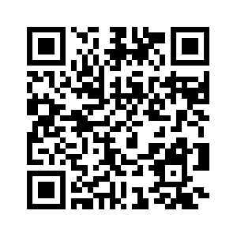
2. Update on Distribution of Sponsored Research Indirect Recovery
The new proposed framework is currently being reviewed and discussed. Considerations include the following
  Allocations to IT (BAC recommendation in January)
  Allocation to campus GRA (to reduce funding volatility on OSP staffing)
Monitoring the Joint Associations Group (JAG) presentation of two alternative models for indirect research cost recovery, summarized HERE
Inputs are still being collected
https://tinyurl.com/SandTBudget
Background Info
The VCFO team is working with relevant constituents to review and develop an updated F&A (reference to BAC February and April Reports)
Policy Memorandum III-27
Policy Memorandum III-30)

Slide 59
3. 2025-26 Salary & Wage Guidelines
  Process: Cindi Nelson, Chief HR, invested considerable time gathering feedback to influence the FY26 program. Stakeholder sessions included the Department Chair Council, Faculty Senate Personnel Committee, Staff Council, Business Leaders, and others.
  Communication: Detailed guidelines shared via e-connection.
  Key points:
    An amount equal to 2.0% of total compensation was set aside for merit.
    Exceptional Performance Pool: None for the fiscal year 2026
    A limited number of lump sum merit awards are available for staff, equivalent to 10% of our total staff count. Awards will be allocated proportionally to divisions, and division leadership will select recipients after reviewing the recommendations from leaders within the division.
    Increases for unsatisfactory performance are not permitted.
    Employees must have completed their annual compliance training to be eligible.

Slide 60
3. Update on 2025-26 Salary & Merit Raise Update - Faculty
  The effective date for pay rate changes: September 1, 2025
  Annual Merit Increases
  Faculty: Recommended by the chair and reviewed/approved by the dean, provost, and chancellor
  Promotions Base Pay Increase
  Faculty who receive a promotional increase are eligible for a merit increase.
Promotion to … | Tenure/Tenure Track | Non-Tenure Track
Associate Professor | $5,000 | $3,000
Full Professor | $10,000 | $6,000

Slide 61
4. Bookstore Vendor Selection Update
  Barnes & Noble is selected to operate the S&T bookstore
  Vital Source remains the digital material publishing and delivery platform
  Students can opt in or opt out of the inclusive textbook offer, which is determined per credit hour
  For faculty who have yet to submit Fall course material adoption, send the adoption information to sm8580@bncollege.com, kbendle@bncollege.com, and emedalis@bncollege.com
  Custom course materials/packs developed by faculty are available for individual purchase in-store or online

Slide 62
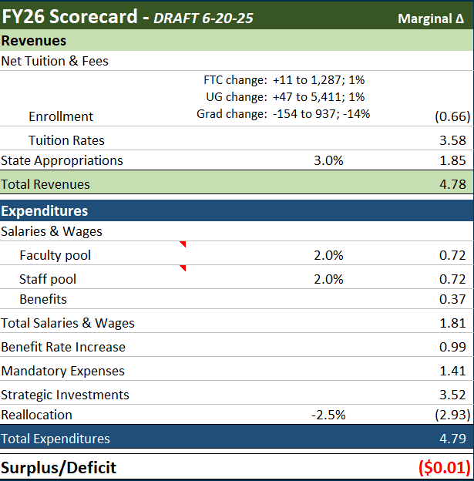
Financial assumptions:
…as of 6-20-25
First-time College: 1% increase
New International Grad: 36% decrease
Tuition increase:
  5% - Undergraduate
  3% - Graduate
State (on Governor’s desk for signature)
  3% increase to base appropriation
  $3M for Small Module Reactors (SMR) science & development
  Protoplex, ARC, Schrenk East & Geothermal expansion
$1.81M set aside for merit program
$3.52M Strategic Investments
$2.93M reallocation

Slide 63
Other news impacting the budget
…as of 6-20-25
Student visa appointments resume on June 18 after a pause
State legislation (on Governor’s desk for signature)
  Veterans Day (November 11) added as UM Holiday
  Minimum wage exemption for public employers removed
    Effective August 28: Minimum wage increases to $13.75/hour
    Effective January 1: Minimum wage increases to $15.00/hour

Slide 64
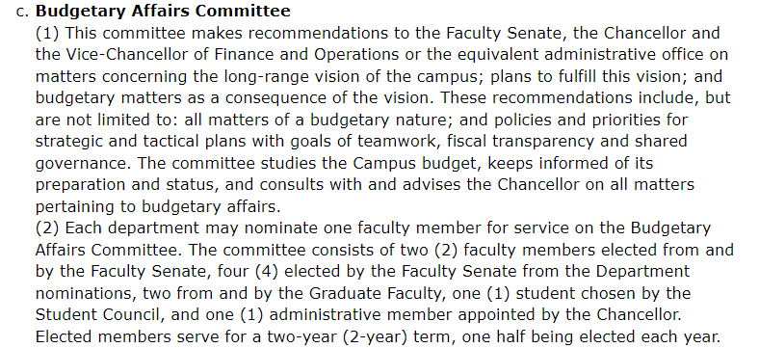














BAC 2024-25 Task Summary
(300.030 Faculty Bylaws of the Missouri University of Science and Technology)
BAC AY 2024 – 2025 Objectives
Financial Stewardship
  Transparency
Trust
  Accountability
Communication

Slide 65
  BAC 2024-25 Task Summary
10% Budget Reallocation for Strategic Focused Area
Net Revenue per Student
F&A Distribution for Negotiated Rate
Report
Report
collect feedback
Report
collect feedback
Grad Research Asst In-State Tuition Funding by Source
Salary & Position Trends: Admin, Faculty, & Staff
IT Modernization
Plan
Report
Report
Report
BAC Recommendations
collect feedback
UMSL Engineering
BAC Recommendations
Stellic cost and information
Effective Financial Position Reporting to Faculty
Report
BAC Recommendations
S&T Bookstore Vendor Evaluation
Report
Report
Starting, Requests made to VCFO

Slide 66
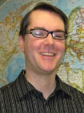
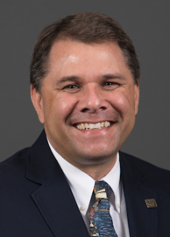
Budgetary Affairs Committee (BAC) Members
Academic Year
2025-2026
E
D
D
D
D
CFO Alysha O'Neil alysha.oneil@mst.edu
Finance & Operations
Dr. Melanie Mormile mmormile@mst.edu CASE
Dr. David Bayless dbayless@mst.edu CEC
Dr. Jag Sarangapani sarangap@mst.edu CEC
Dr. Michael Meagher
mmeagher@mst.edu CASE
Membership:
Faculty Senate (FS): 2
Department (D): 4
Graduate Faculty (G): 2
Student Council (StuC): 1
Chancellor Appointed: 1
FS
FS
G
G
StuC
Dr. Kelly Homan khoman@mst.edu, CEC
Dr. Bih-Ru Lea leabi@mst.edu Kummer
Dr. Michael Moats
moatsm@mst.edu
CEC
Graduate Faculty Council
Mr. Logan Garton lwgcf2@mst.edu
Student Council, Civil Eng

Slide 67
  BAC 2025 - 26 Plan
  2025-2026 Plan
    Monthly meeting: 12:15 – 1:45 p.m. Wednesday, 2nd week of each month, except 11/5 & 1/14
    Planning Meeting: September 10. Requests to BAC by 11:59 pm on Monday, 9-9 via email or input form.
  Communication Plan
    Current: Faculty Senate Meetings, Department Chair Council
    In considerations
      BAC provides a one-page summary to department chairs, senators, and the Provost prior to each Faculty Senate meeting
      A more detailed Faculty Senate meeting agenda to keep faculty informed and encourage attendance
Provide Input or Request Information
https://tinyurl.com/SandTBudget

Slide 68
VII. Committee Reports
C. Information
Technology
D. Stutts

Slide 69
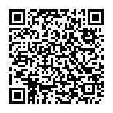
2025 Spring IT Survey – Final Report
Final report from Spring 2025 Survey of IT performance is available for S&T community (link/QR below)
  IT-Survey-Early Spring 2025-Report-FINAL.pdf --->
  ITCC plans to repeat survey twice a year to track
  progress and update goals for IT/ITCC
    Next one in October 2025

Slide 70
VII. Committee Reports
D. Personnel
D. Westenberg

Slide 71
Personnel Committee
Dave Westenberg
Completed revisions of Teaching Improvement plans
  Discussion
  Next Steps
Motion: The Personnel committee moves that the Faculty Senate endorse the use of the proposed Teaching Improvement Plan document to facilitate discussions between chairs and faculty to improve teaching.

Slide 72
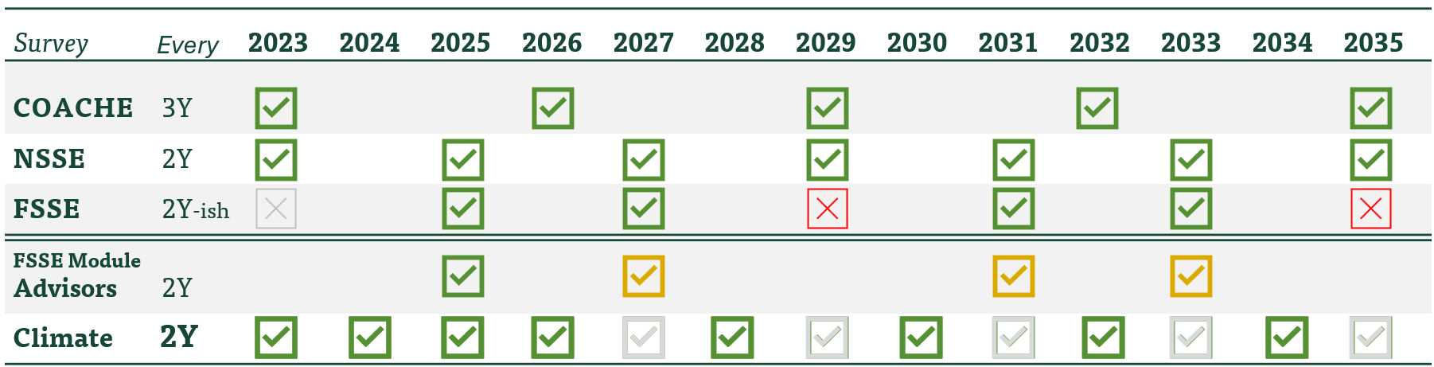
Personnel Committee
Dave Westenberg
Annual Campus Climate Survey
  Not ready to present quantitative data yet
  Discussion of plans to revise the frequency of surveys

Slide 73
VII. Committee Reports
D. Public Occasions
A. Behrendt

Slide 74
Graduate Ceremonies
The Public Occasions Committee moves to combine the Master's and Doctoral graduation ceremonies so that, beginning with the Fall 2025 term, both take place at the Friday evening commencement ceremony.

Slide 75
VIII. Unfinished Business
D. Westenberg

Slide 76
IX. New Business
D. Westenberg

Slide 77
X. Q&A

Slide 78
XI. Announcements
D. Westenberg

Slide 79
XII. Adjourn

Slide 80
Thank You
D. Westenberg
President, Faculty Senate
djwesten@mst.edu
facultysenate.mst.edu

